Slide 1

Storm is coming.. Are you safe!?
Huzefa Saifee - u1274086@utah.edu
Siddharth Hatkar - u1273107@utah.edu
Soumith Reddy Mada - u1288778@utah.edu

Slide 2
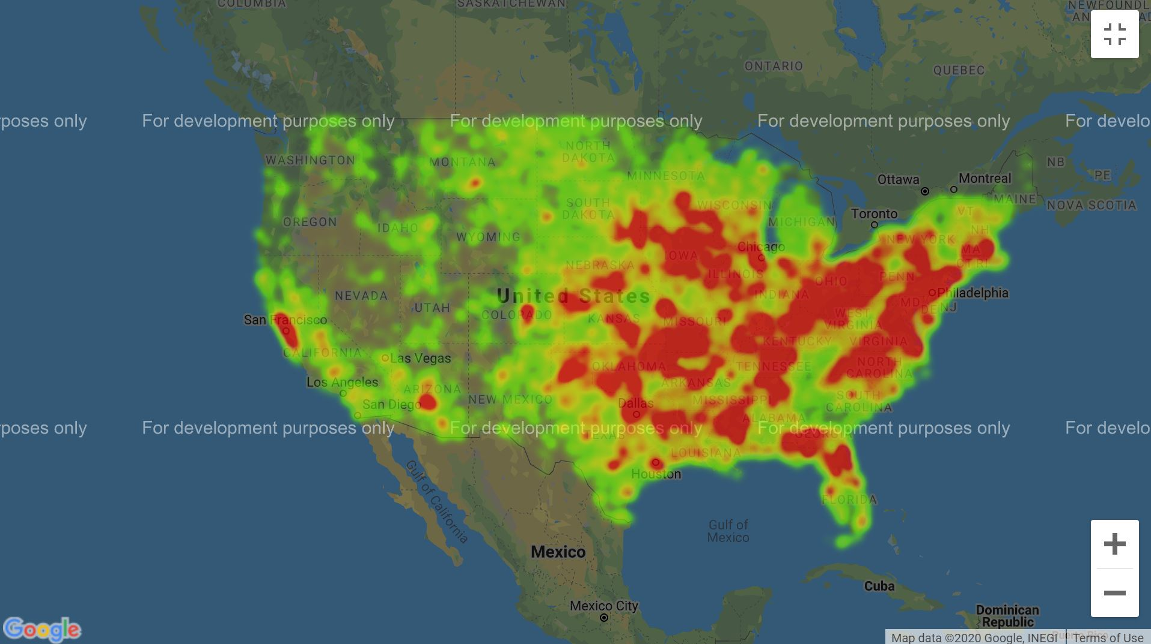
Affected Regions in USA in Past 3 years

Slide 3
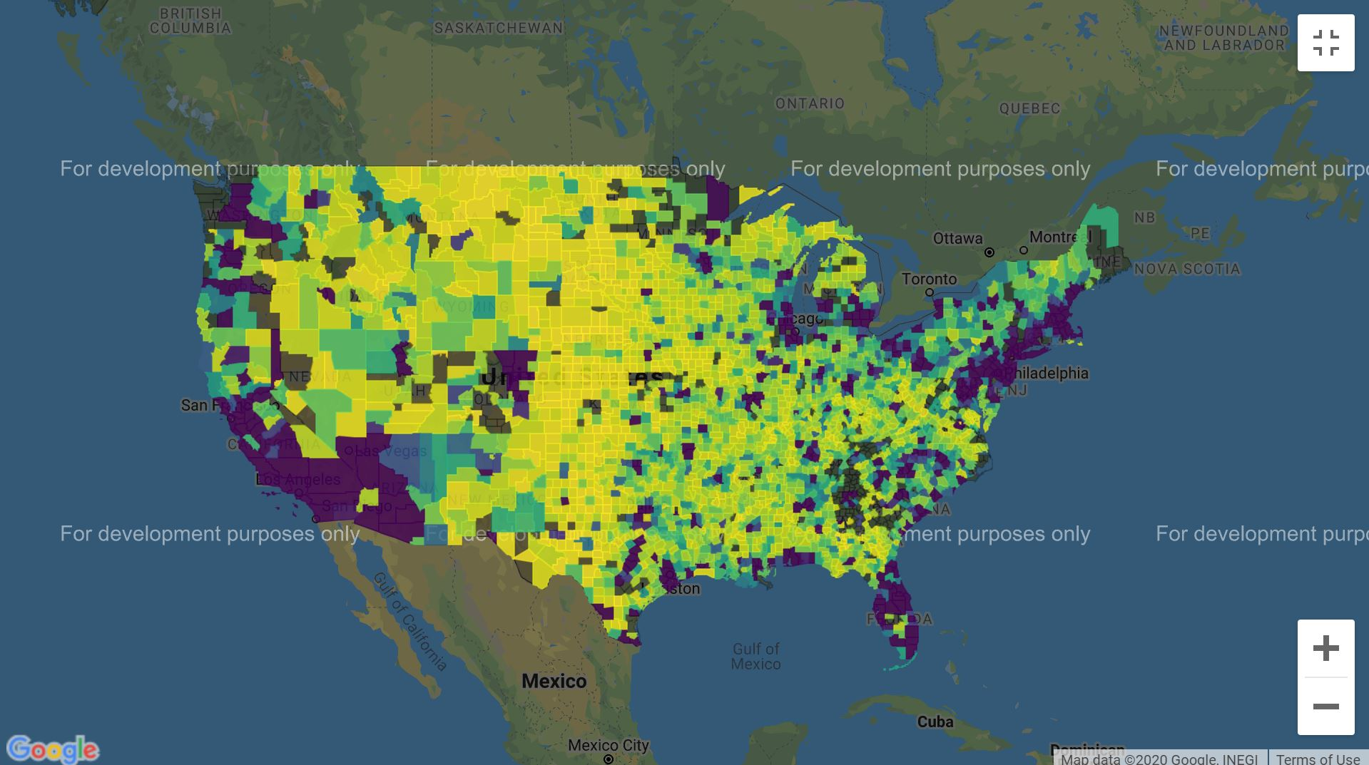
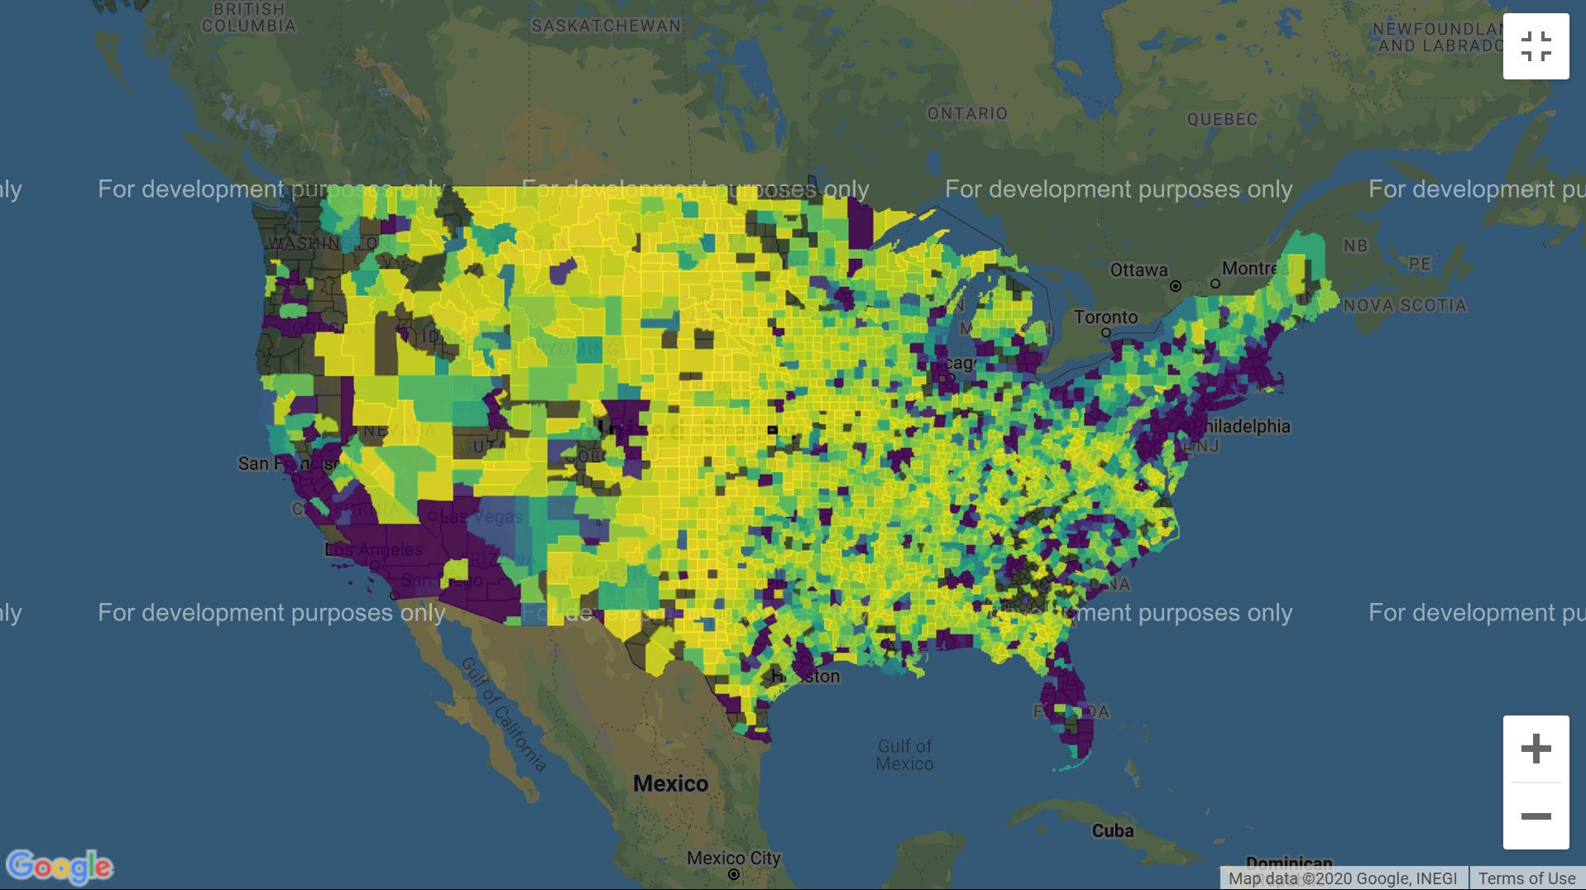
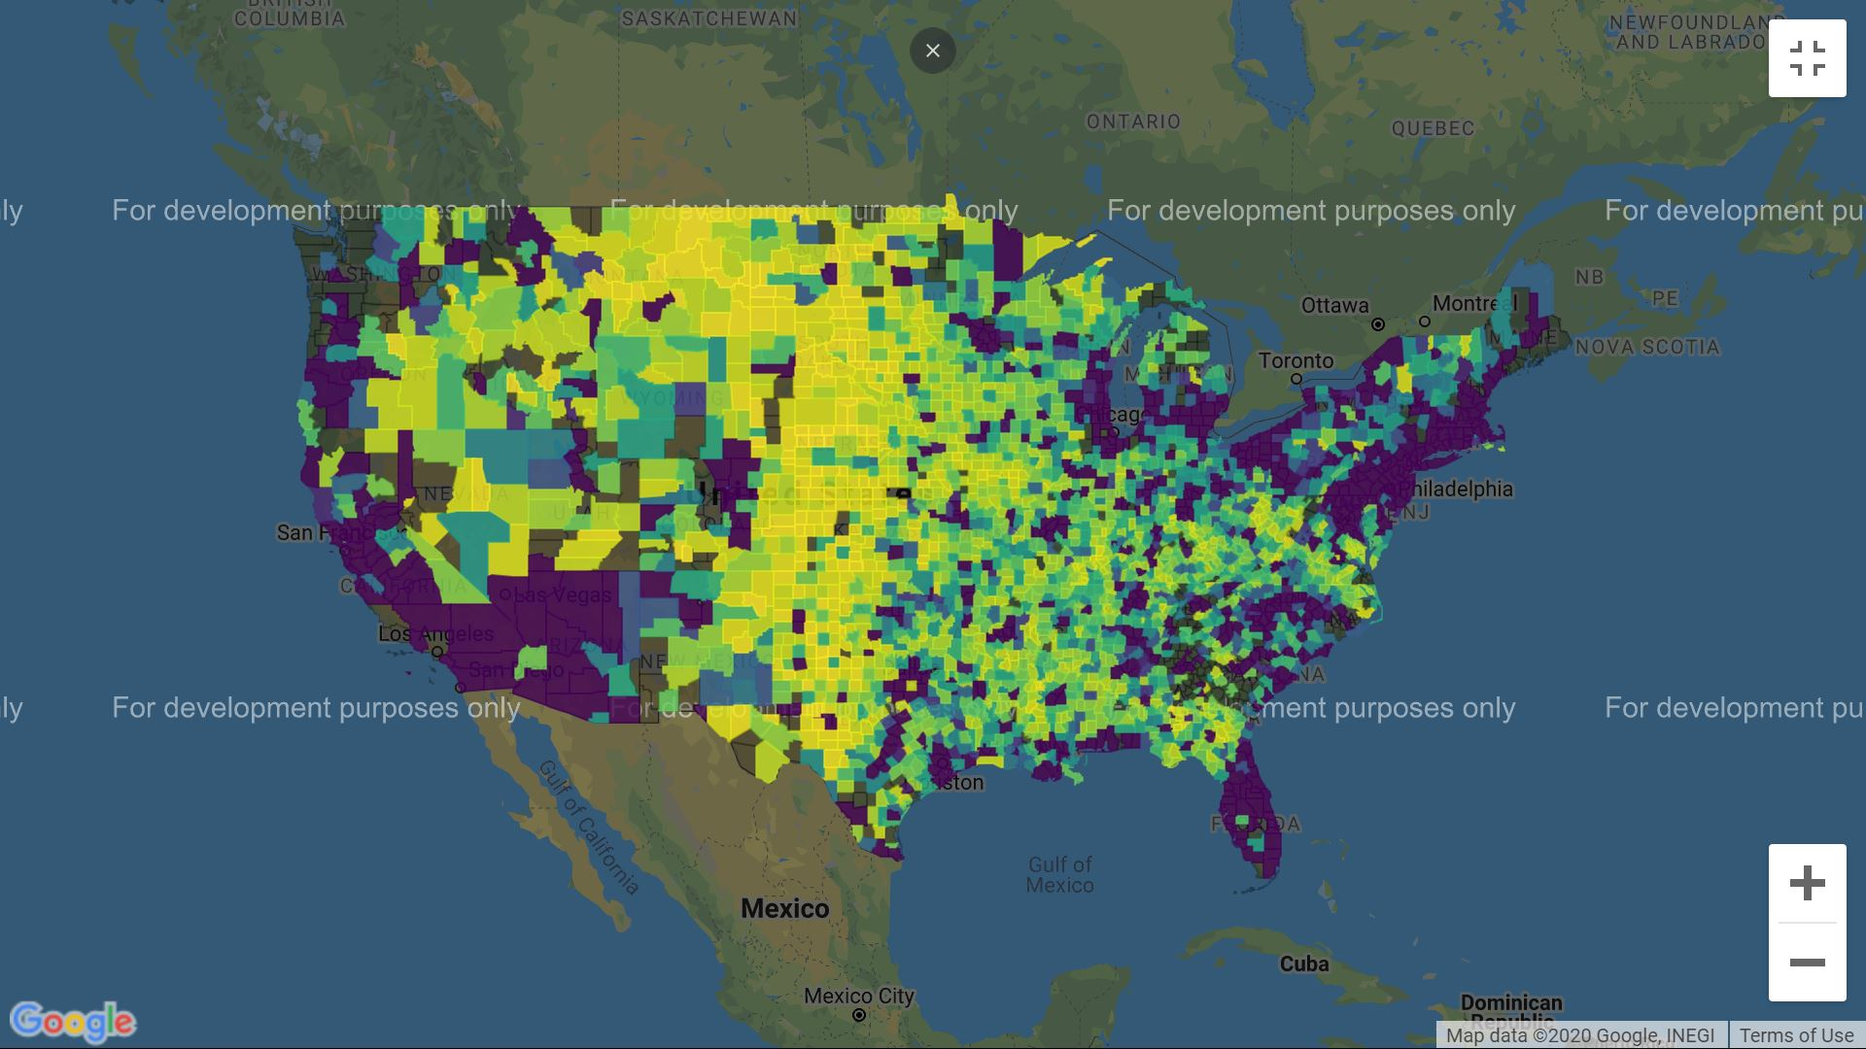
Population distribution for counties in 2017
Population distribution for counties in 2018
Population distribution for counties in 2019

Slide 4
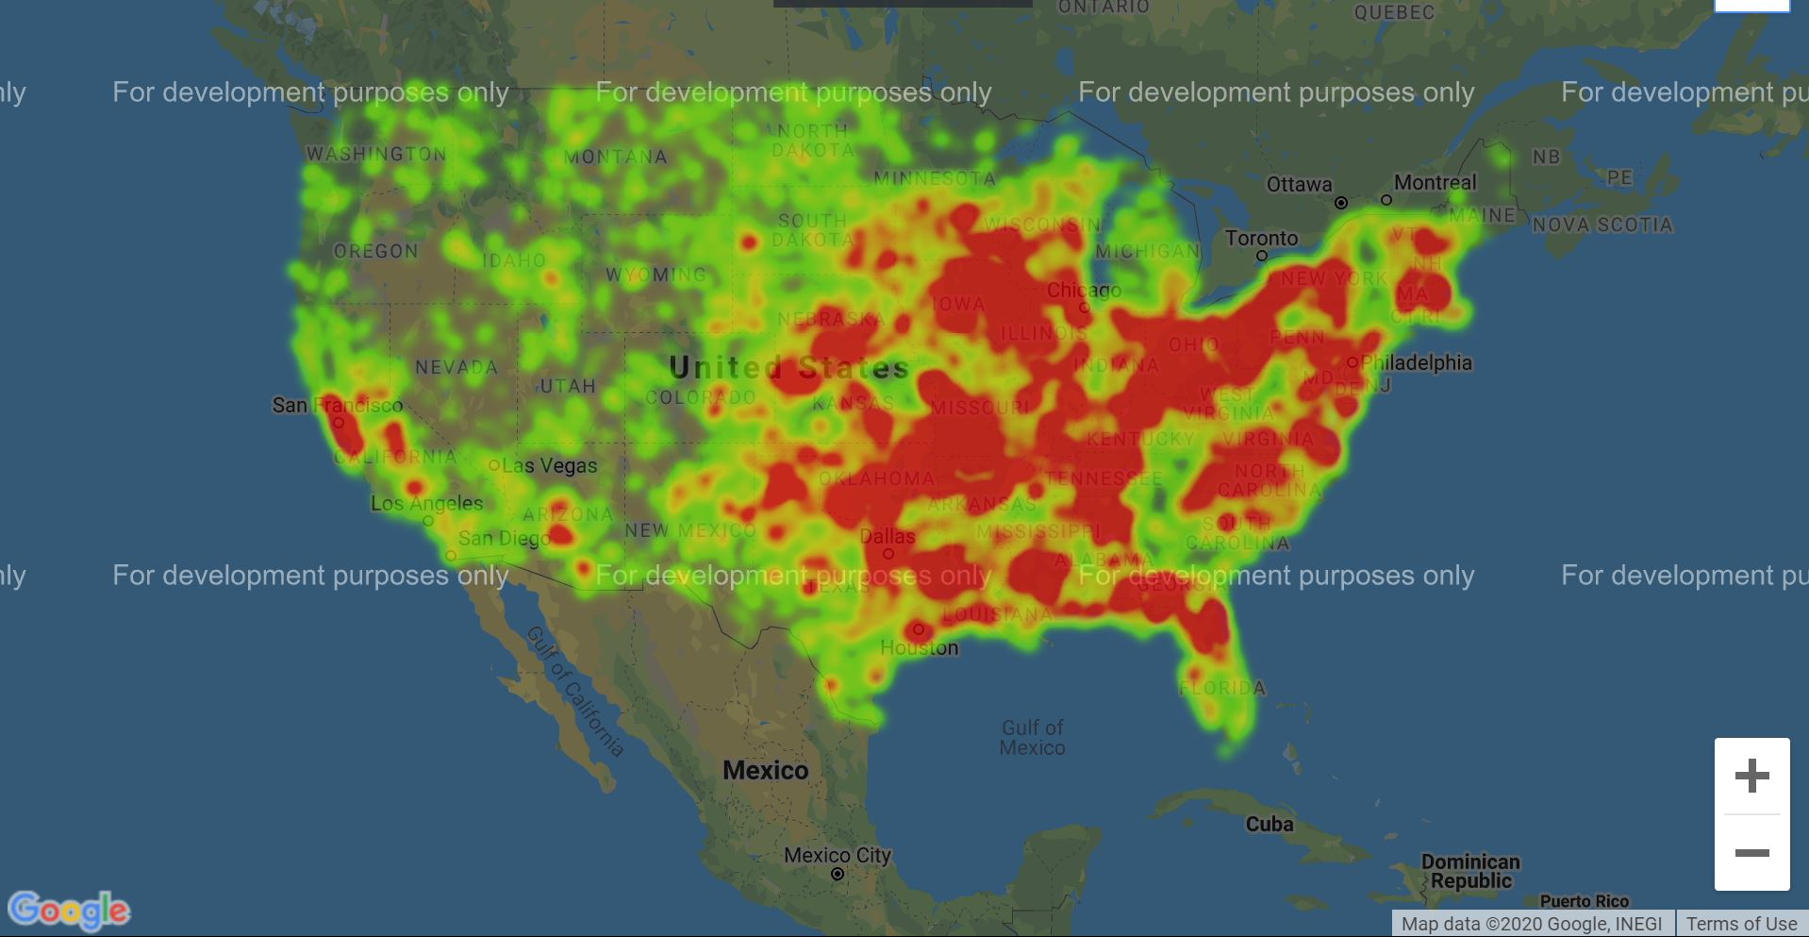
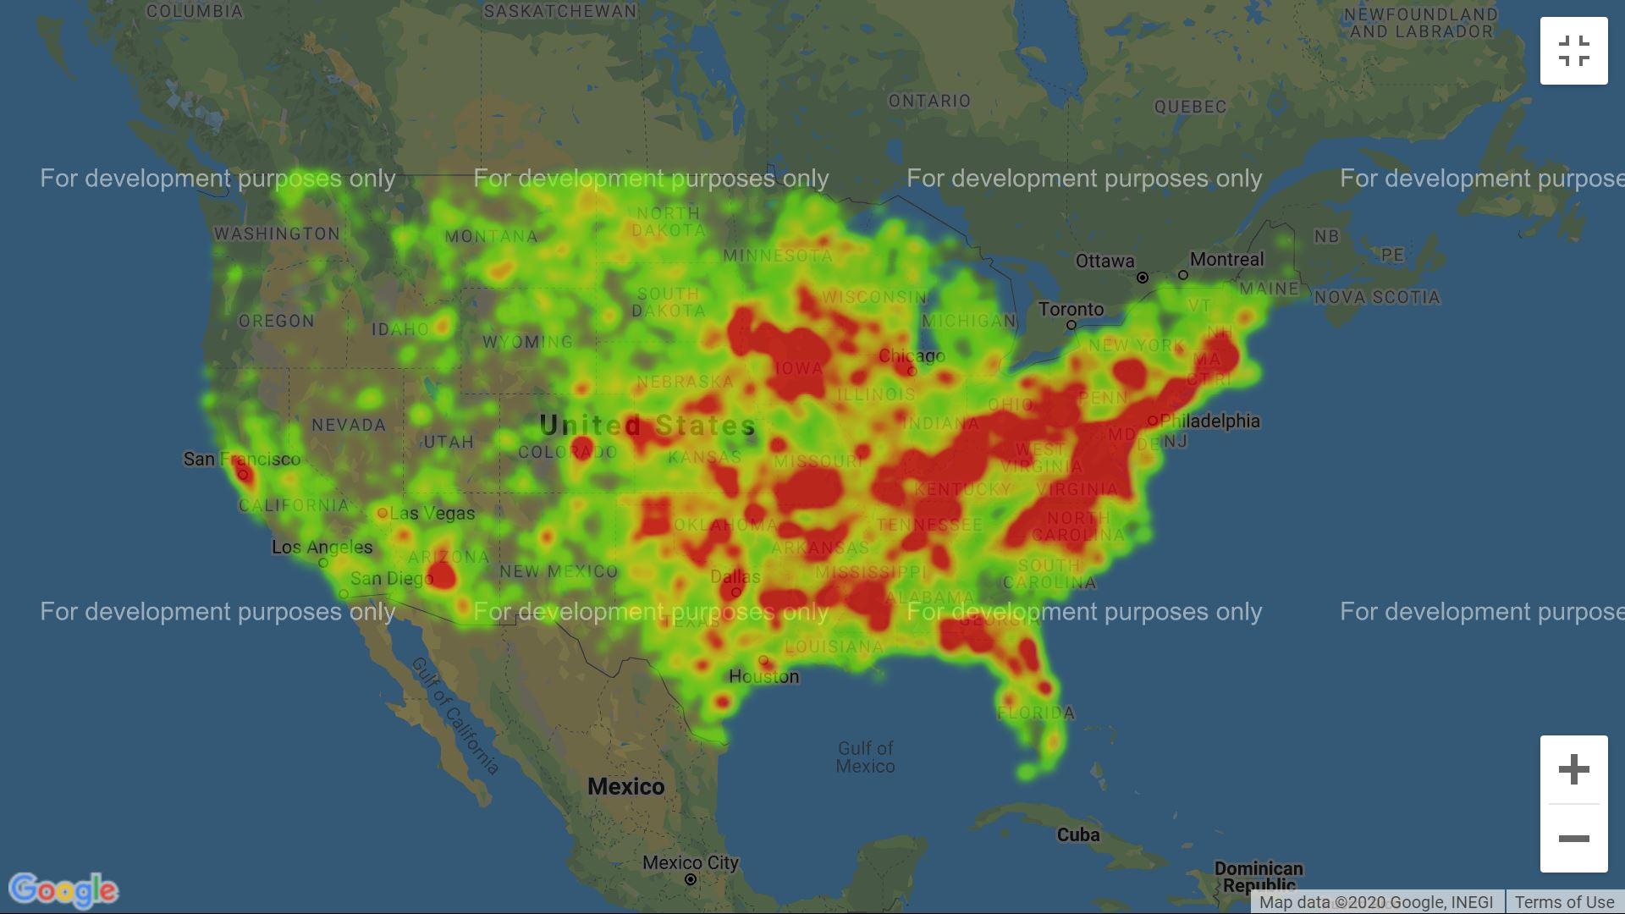
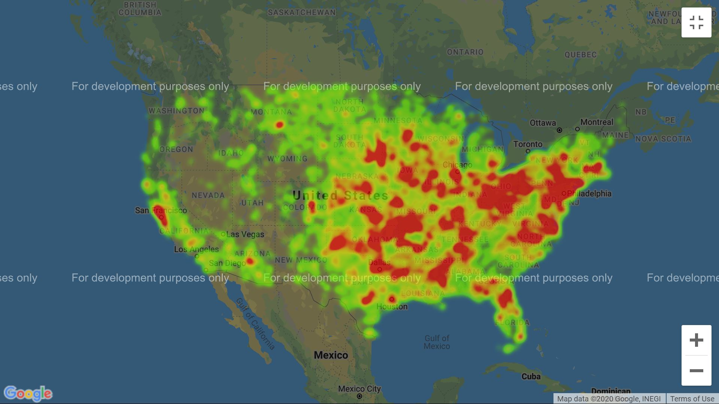
Affected Regions in USA in the year 2017
Affected Regions in USA in the year 2018
Affected Regions in USA in the year 2019

Slide 5
Data Analysis of deaths, Injuries, total damage for each state and each year

Slide 6
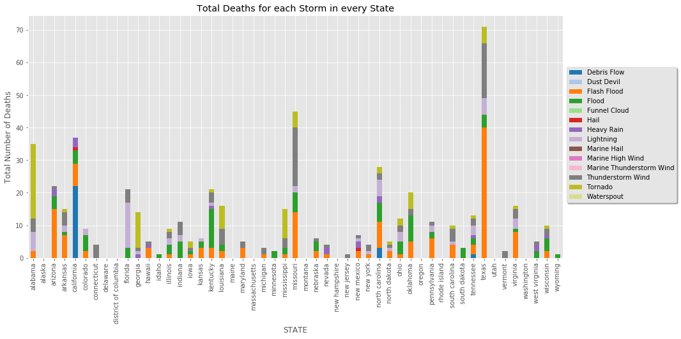
Texas recorded the highest number of deaths out of all states with number more than 70.
Flash Flood caused around 40 deaths for Texas state
In general, Flash Flood caused most deaths around 150 deaths.
Deaths in Alabama are highly affected by the Tornados.
Deaths in California are mostly due to the debris flow.

Slide 7
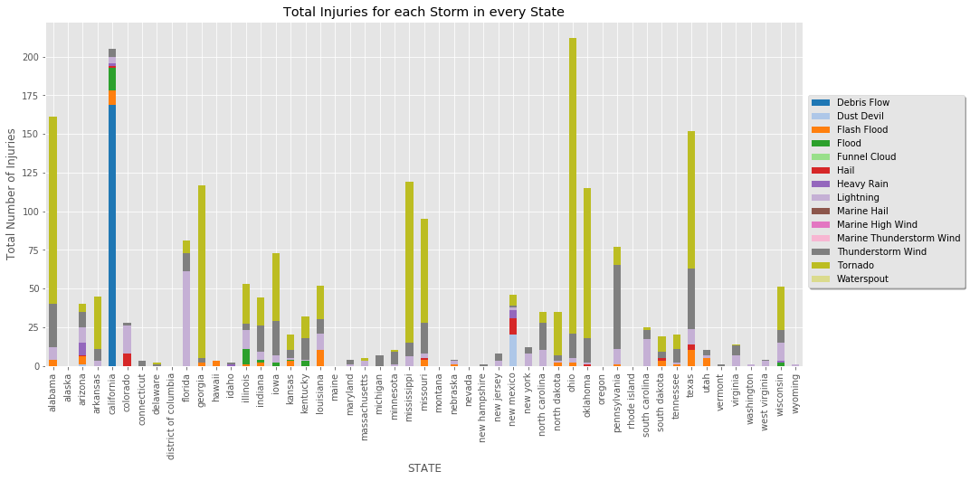
Ohio recorded the highest number of Injuries out of all states with number around 200+.
Tornados caused more Injuries in Ohio state. However, the deaths caused are comparatively low.
In general, Tornado caused most Injuries: 1000+.
Also, just like most number of deaths, highest number of injuries in California are caused by the debris flow only, which brings us to a conclusion that the govt. should take better preventive measures against this natural calamity.

Slide 8
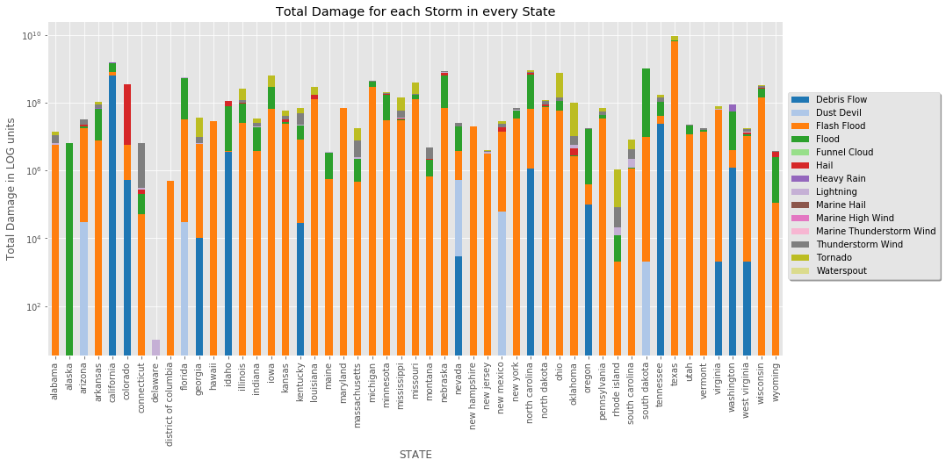
The above plot is a logarithmic scale and shows that Texas not only has the highest deaths but is also the most damaged state in the USA.
Flash flood caused most of the damage in many states. However, most damage caused to California is due to the debris flow.
USA has suffered a loss of billions of dollars in just the past three years

Slide 9
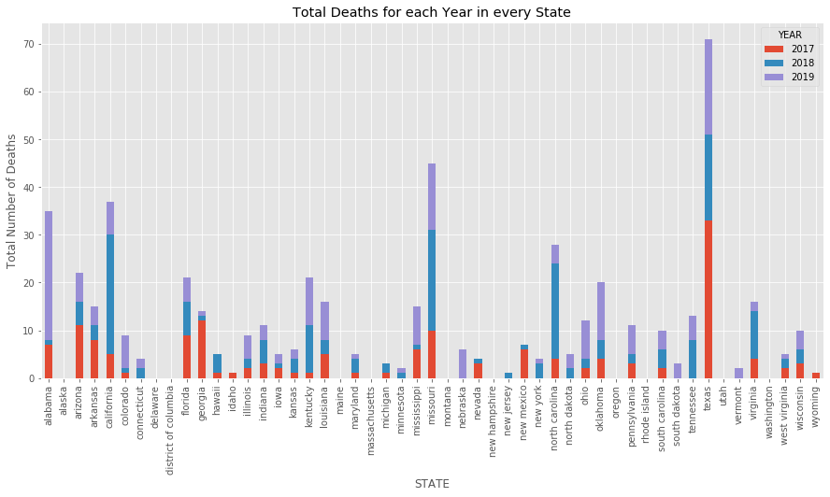
Deaths are almost equal for the past three years. However, with the increase in population every year, the number of deaths have also increased but not that significantly.
2019 has highest deaths of 194 and least being in 2017

Slide 10
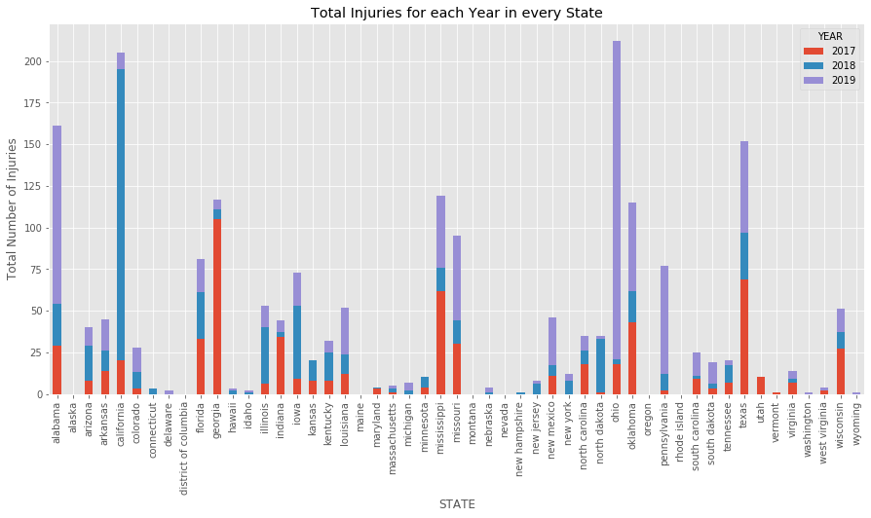
2017 Has least injuries.
2019 has highest injuries of 834.
Ohio has a high number of injuries in just the year of 2019, while in the California, there is a huge decline in the number of injuries as compared to 2018.

Slide 11
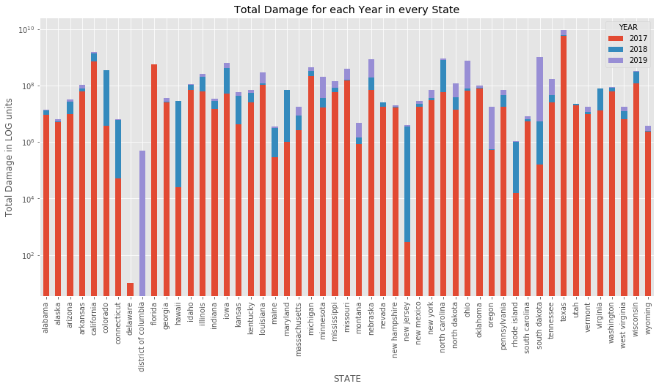
2017 is the most damaged year due to storms.
2018 is the least damages year.
Most of the states in the USA has suffered damage worth more than millions of dollars in the year 2017. Afterwards the trend has decreased drastically, this can be due to the preventive measures taken after the loss in the year 2017.

Slide 12
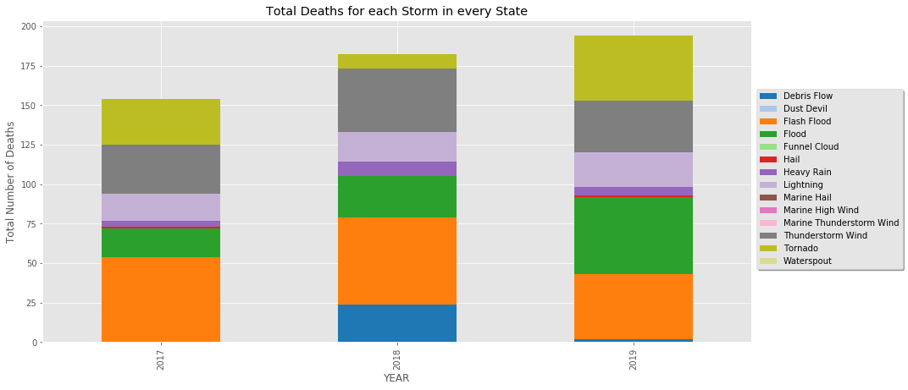
From the above graph we can say that Flash Floods have been a constant cause of highest number of deaths in USA. Although, The Floods and Tornados have higher number of deaths in 2019 as compared to the past years.

Slide 13
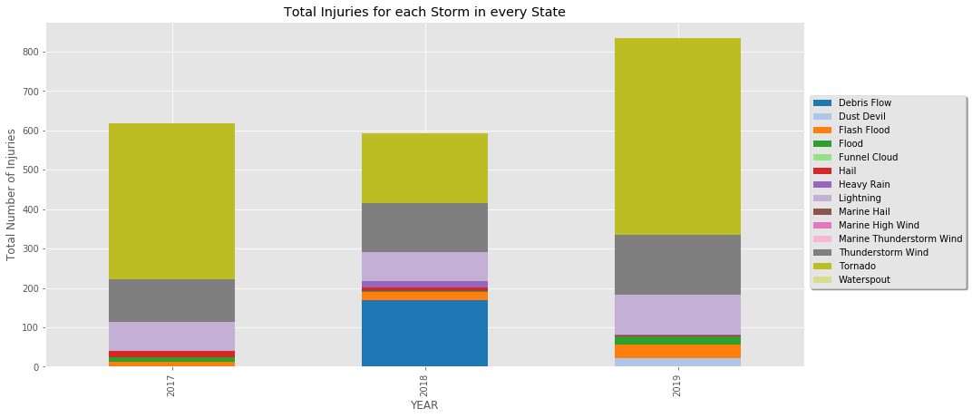
The Tornado have been a constant cause of highest number of injuries every year.

Slide 14
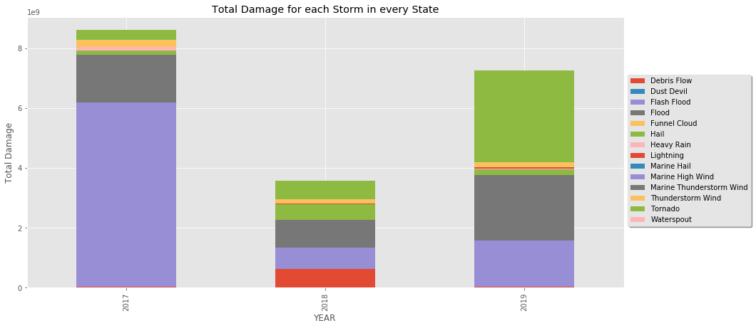
It is evident that the USA government has taken various preventive measures to reduce the damage caused by the Flash Floods after 2017, but in 2019 Tornado has been a major cause of total damage caused to the USA.

Slide 15
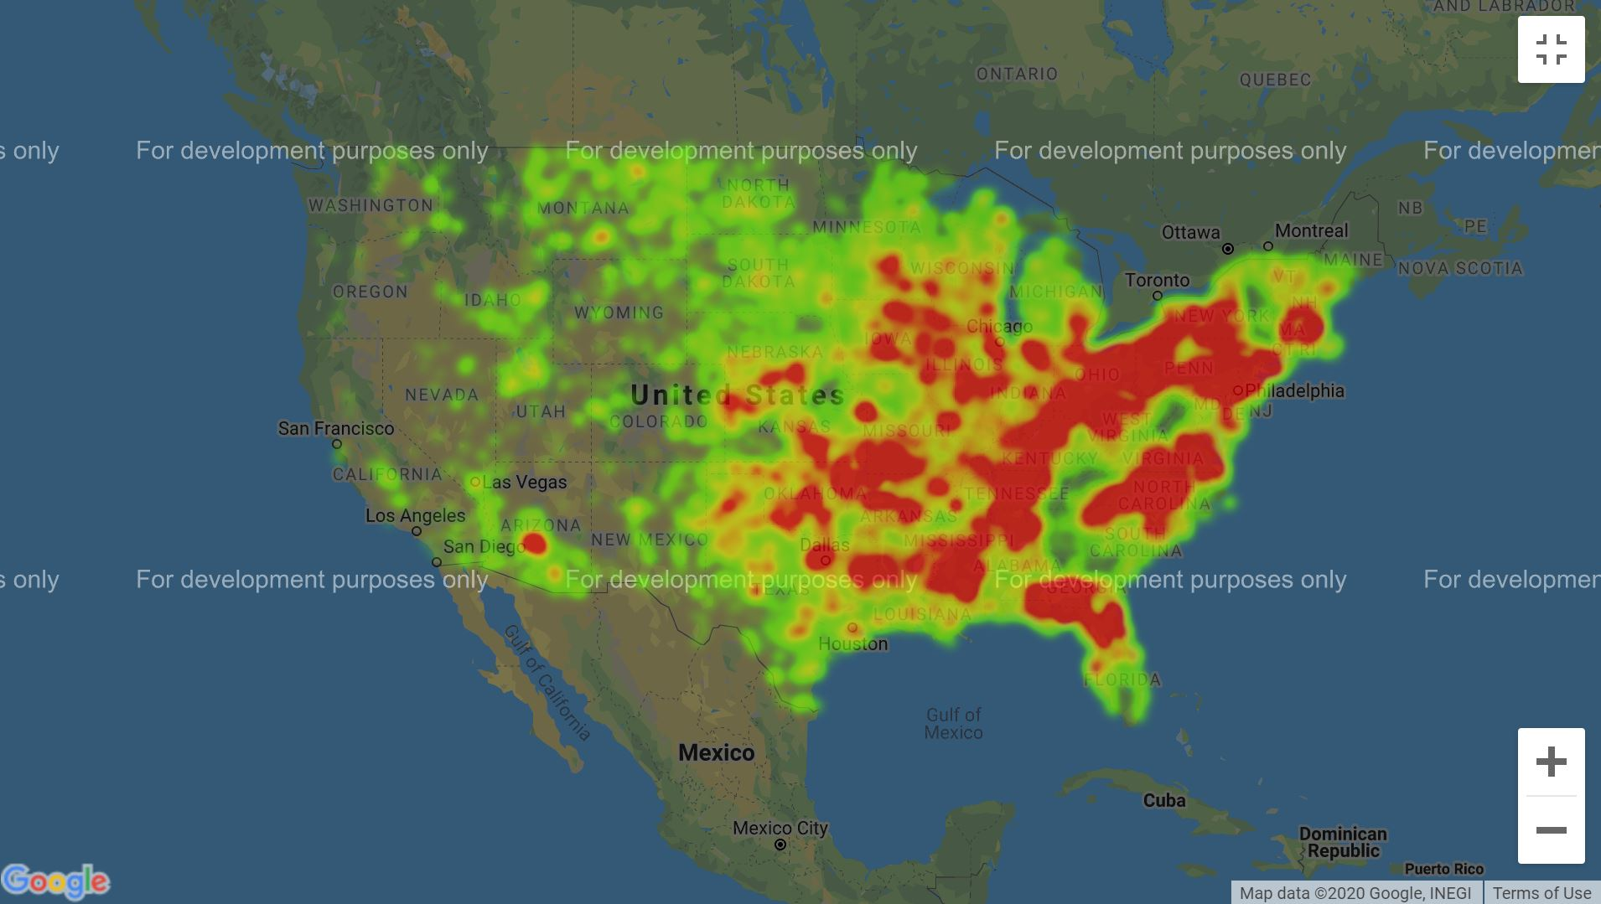
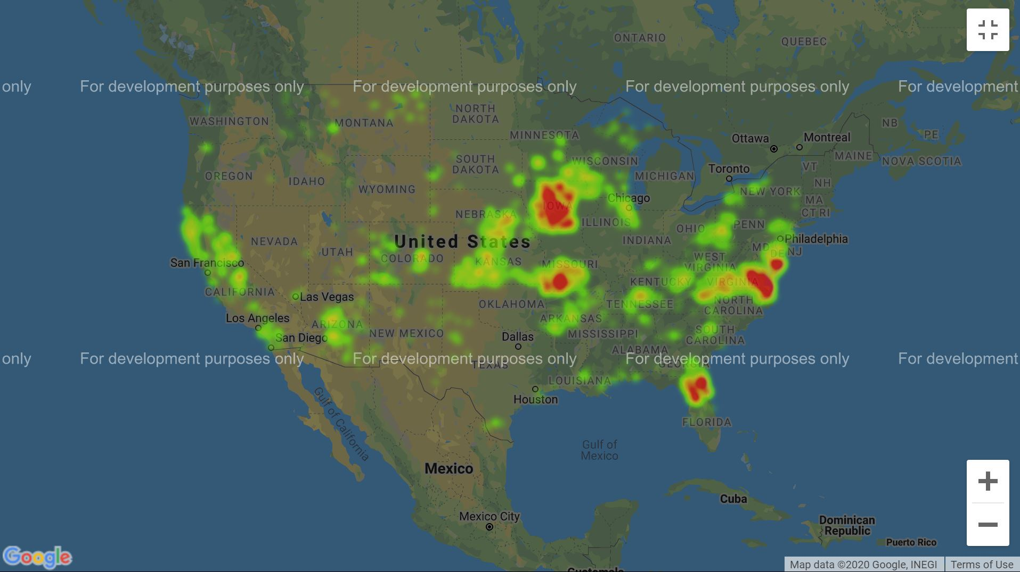
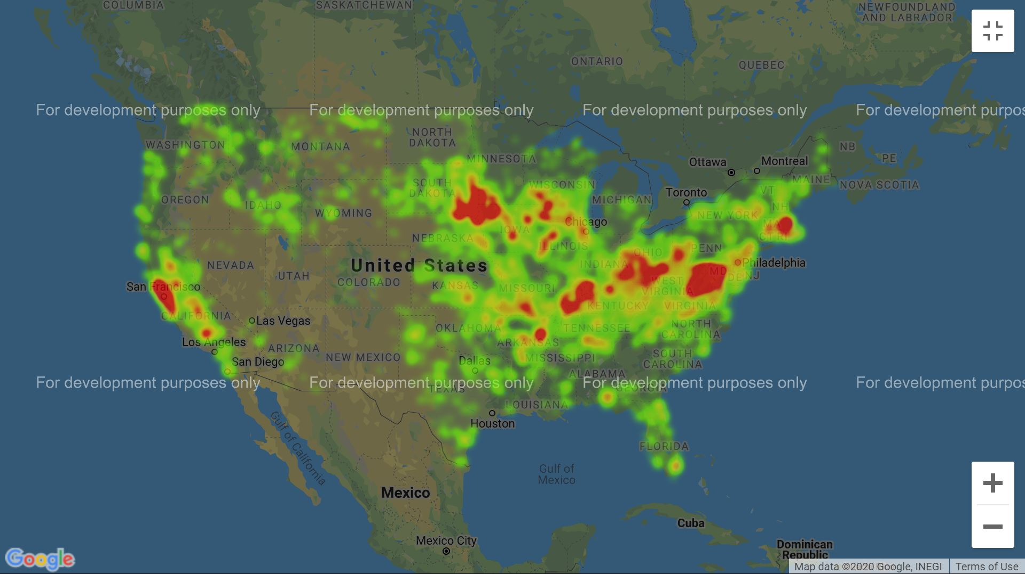
Affected Regions due to Heavy Rains in USA
Affected Regions due to Thunderstorms in USA
Affected Regions due to floods in USA

Slide 16
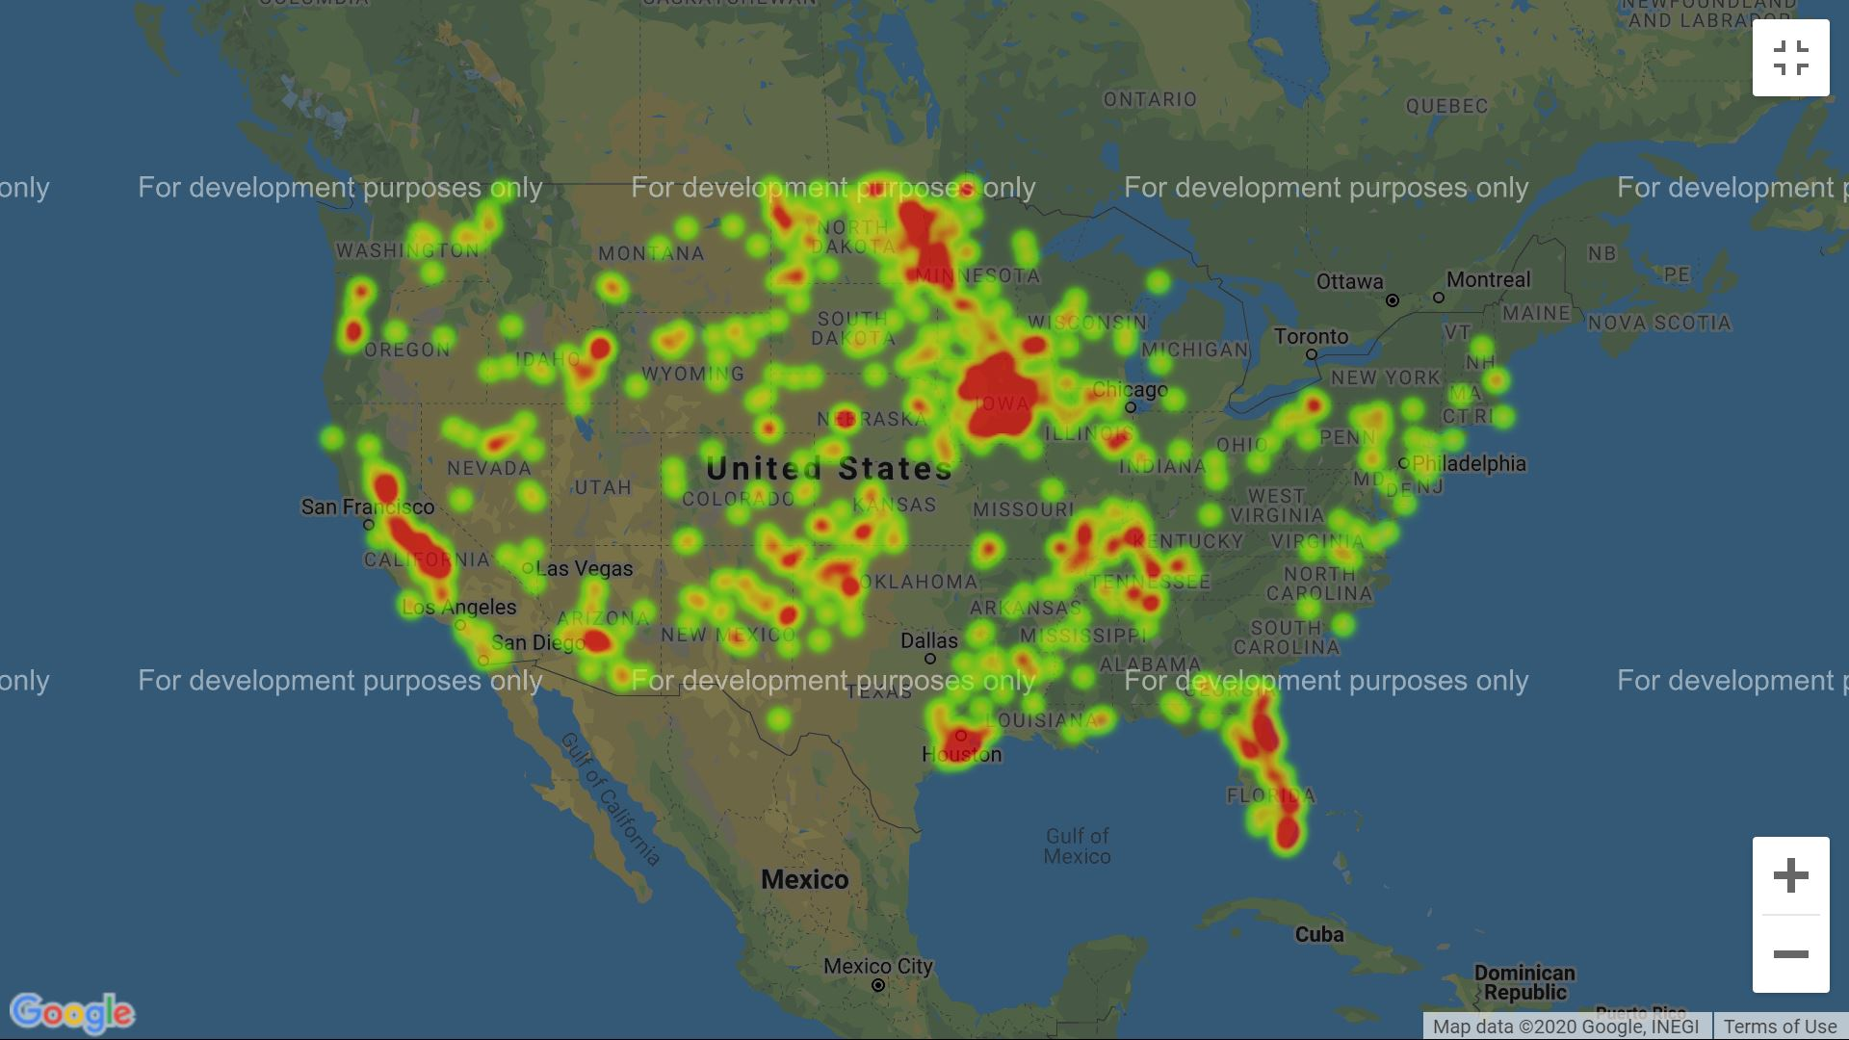
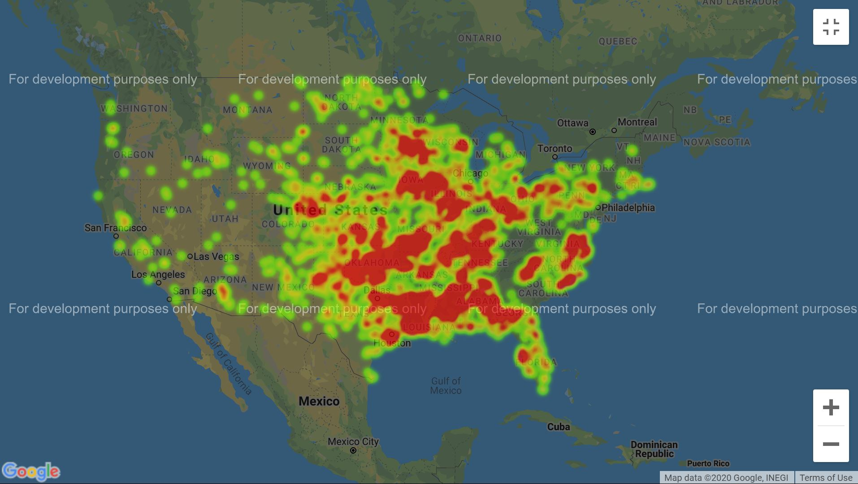
Affected Regions due to funnel cloud in USA
Affected Regions due to Thunderstorms in USA
Affected Regions due to Tornado in USA

Slide 17
Data sources
Data gathered from : https://www1.ncdc.noaa.gov/pub/data/swdi/stormevents/csvfiles/?C=M;O=D
We have merged all the 3 years data set for our analysis
The Metadata of the columns is described in the following link: http://www1.ncdc.noaa.gov/pub/data/swdi/stormevents/csvfiles/Storm-Data-Export-Format.docx
Fetching county population using the census data for respective year where the storms occurred: https://www2.census.gov/programs-surveys/popest/tables/2010-2019/counties/totals/co-est2019-annres.xlsx
Fetching county names using the latitudes and longitudes from the following website: https://geo.fcc.gov/api/census/

Slide 18
Data Gathering & processing
Merged 2017,2018 & 2019 data sets
Updated County names based on Latitudes & Longitudes using Free FCC API
Fetched the data for individual counties based on the year and state they belong to
We had more than 200,000 rows of data for three years and we filtered to around 90,000 rows.
Performed necessary actions like converting data types, figuring out to remove unnecessary columns.

Slide 19
Thank you ☺

